Slide 2
Darwin Rivera
Application: Just4KickzBlog
Updated 4/1/2019

Slide 3
Sneaker Head- One who is in love with shoes but not limited to Jordans, Forces, Dunks, Maxes, willing to camp out and face lines that wind around blocks for a pair of once in a lifetime exclusives!

Slide 4
GOAL
As a sneaker head I wanted to create a blog/website for the shoe Aficionado. Users can see
what shoes are releasing and provide them with pictures and information.

Slide 5
TARGET USER
People looking to stay informed on new shoes, release dates etc.
People who want to learn about shoes and read current posts and provide feedback.

Slide 6
How I plan to do this
provide a easy to navigate User Interface
Provide users with shoes for the week with pictures and descriptions as well as current market prices for those looking to purchase.
Open the floor to users where they can provide feedback, ask questions etc.

Slide 7
SQL SCRIPTS
CREATE TABLE [dbo].[Shoes] (
[Id] INT IDENTITY (1, 1) NOT NULL,
[Name] NVARCHAR (MAX) NULL,
[ShortDescription] NVARCHAR (MAX) NULL,
[LongDescription] NVARCHAR (MAX) NULL,
[Price] DECIMAL (18, 2) NOT NULL,
[ImageUrl] NVARCHAR (MAX) NULL,
[ImageThumbnailUrl] NVARCHAR (MAX) NULL,
[IsShoeOfTheWeek] BIT NOT NULL,
[IsInStock] BIT DEFAULT ((0)) NOT NULL,
CONSTRAINT [PK_Shoes] PRIMARY KEY CLUSTERED ([Id] ASC)
);
CREATE TABLE [dbo].[Feedbacks] (
[FeedbackId] INT IDENTITY (1, 1) NOT NULL,
[Name] NVARCHAR (MAX) NULL,
[Email] NVARCHAR (MAX) NULL,
[Message] NVARCHAR (MAX) NULL,
[ContactMe] BIT NOT NULL,
CONSTRAINT [PK_Feedbacks] PRIMARY KEY CLUSTERED ([FeedbackId] ASC)
);

Slide 8
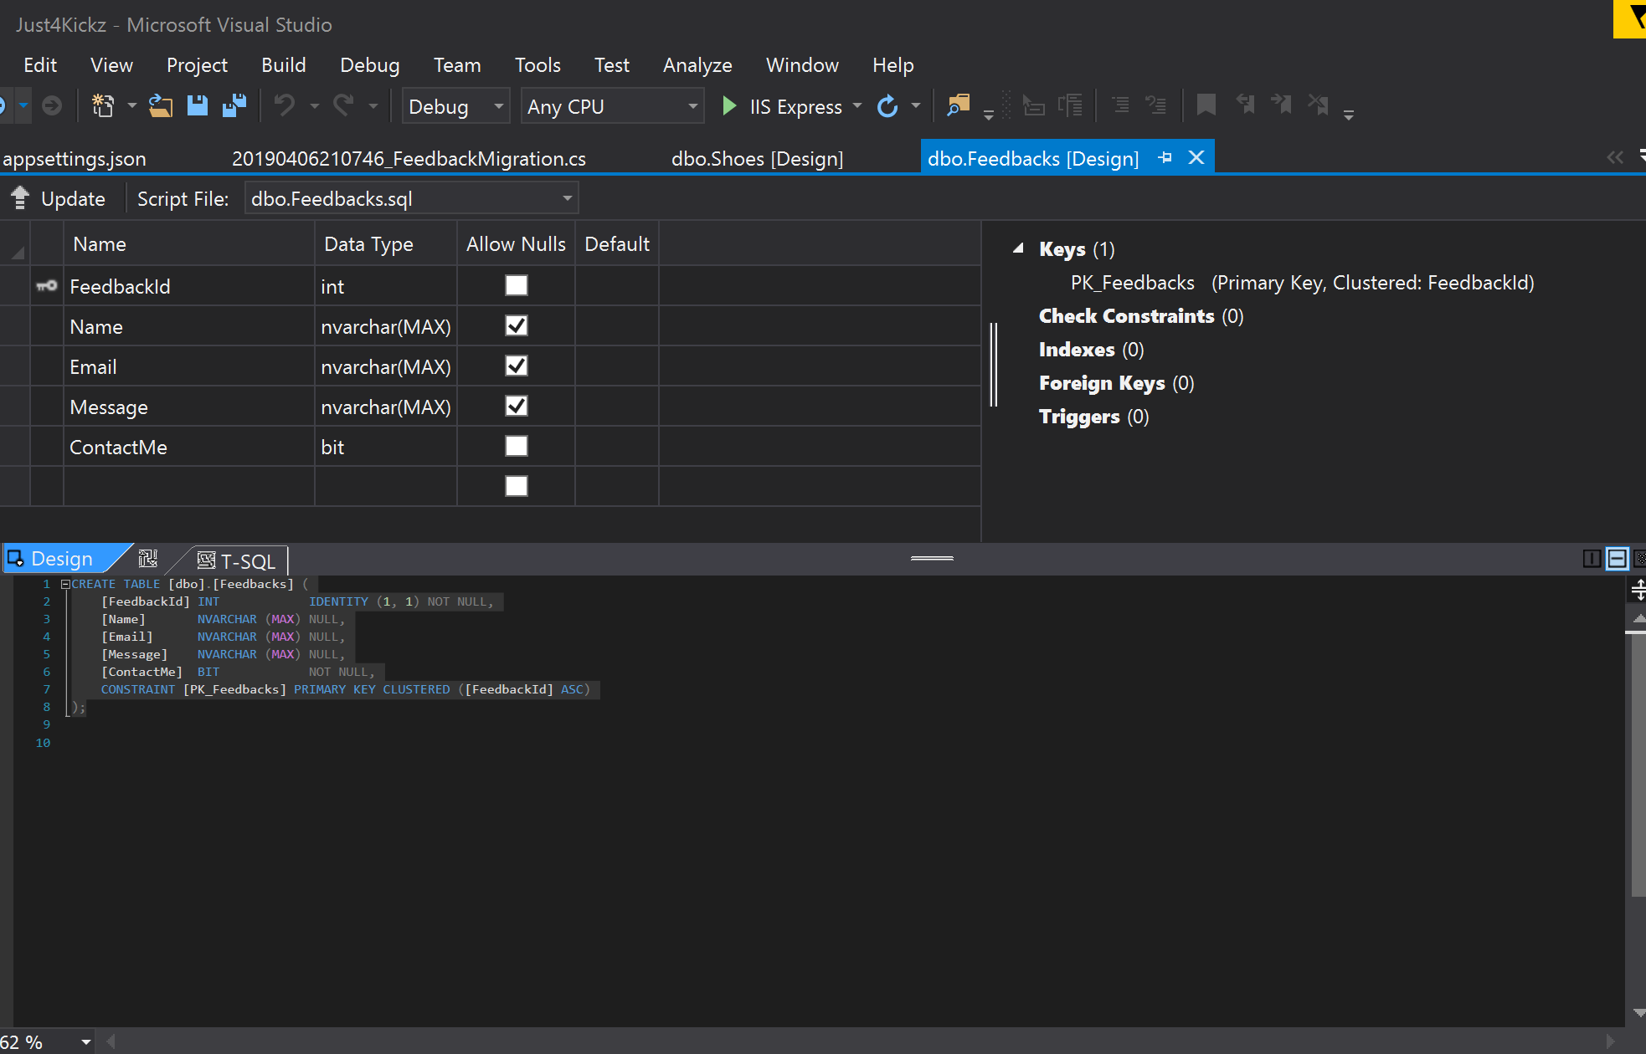

Slide 9
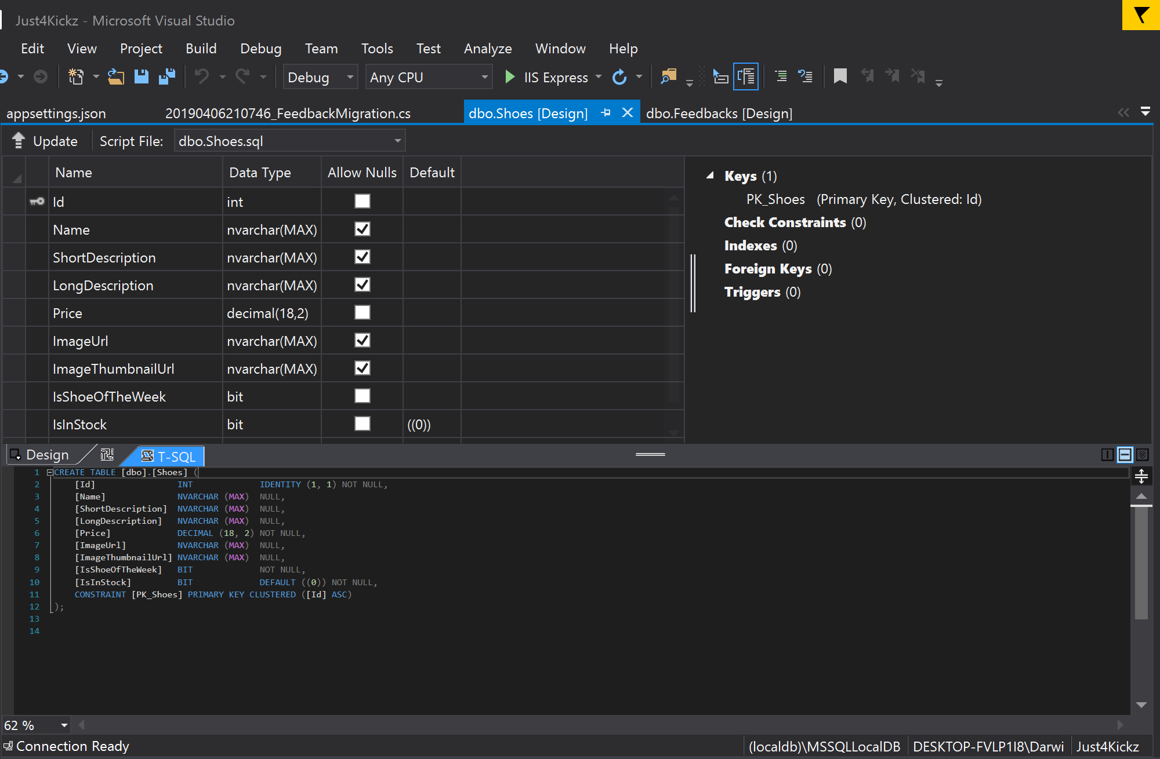

Slide 10
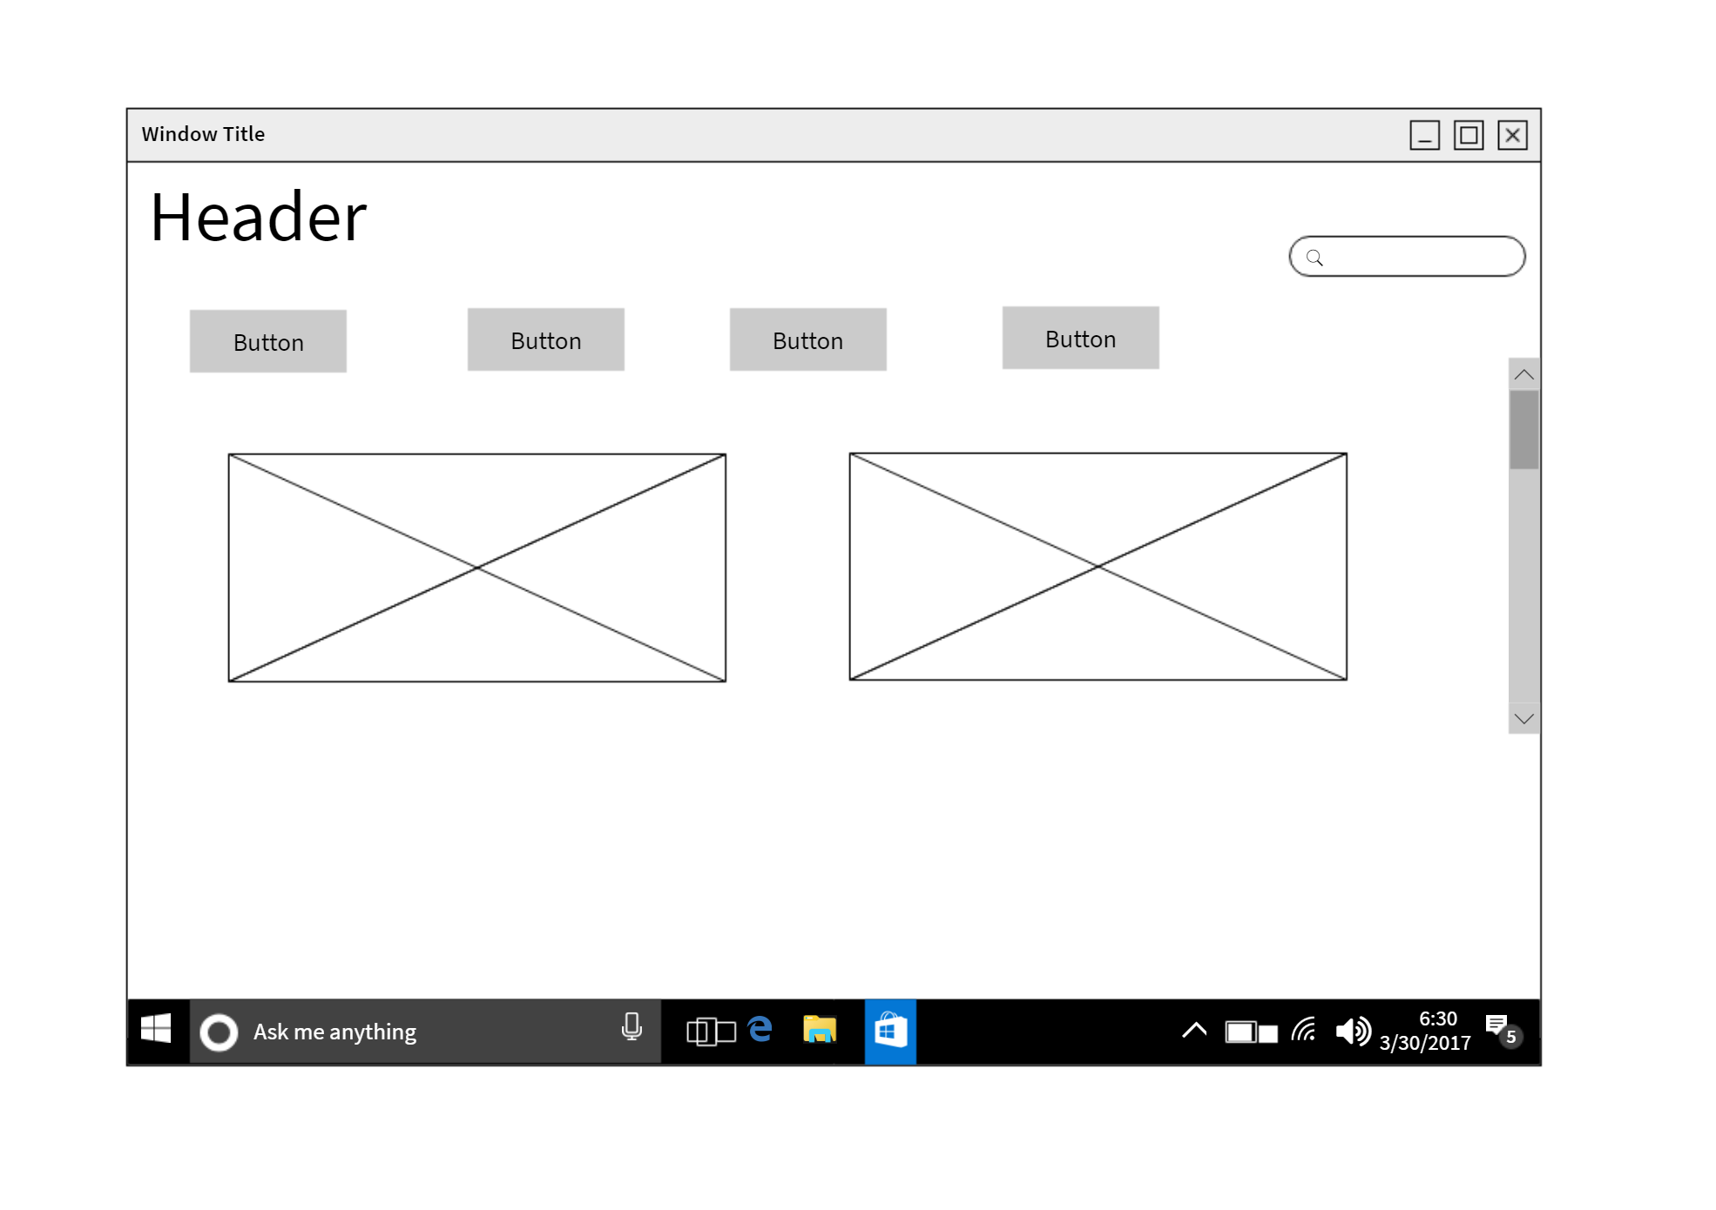
Design

Slide 11
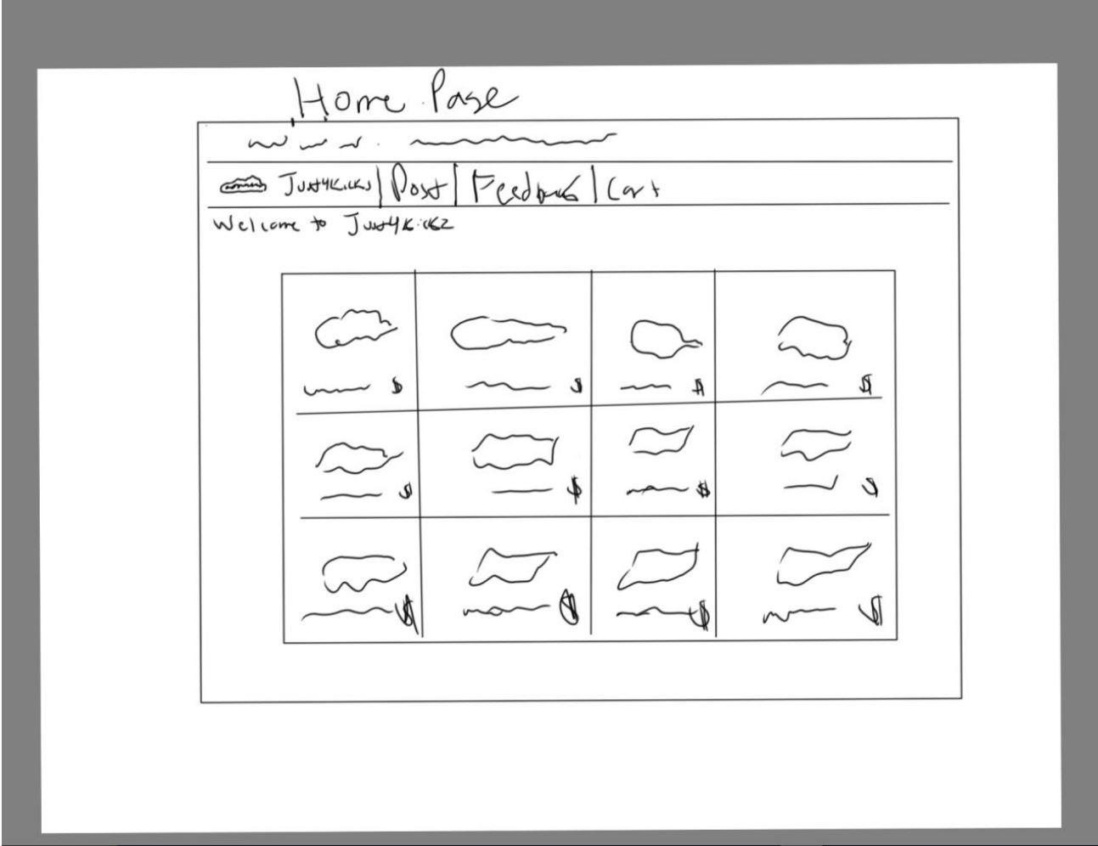

Slide 12
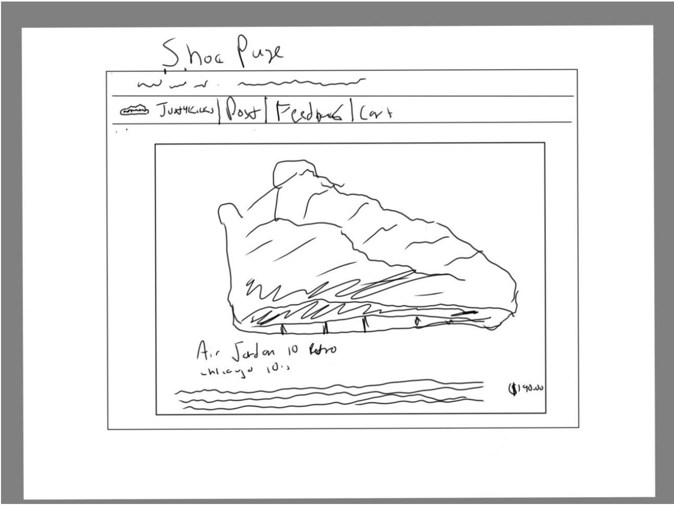

Slide 13
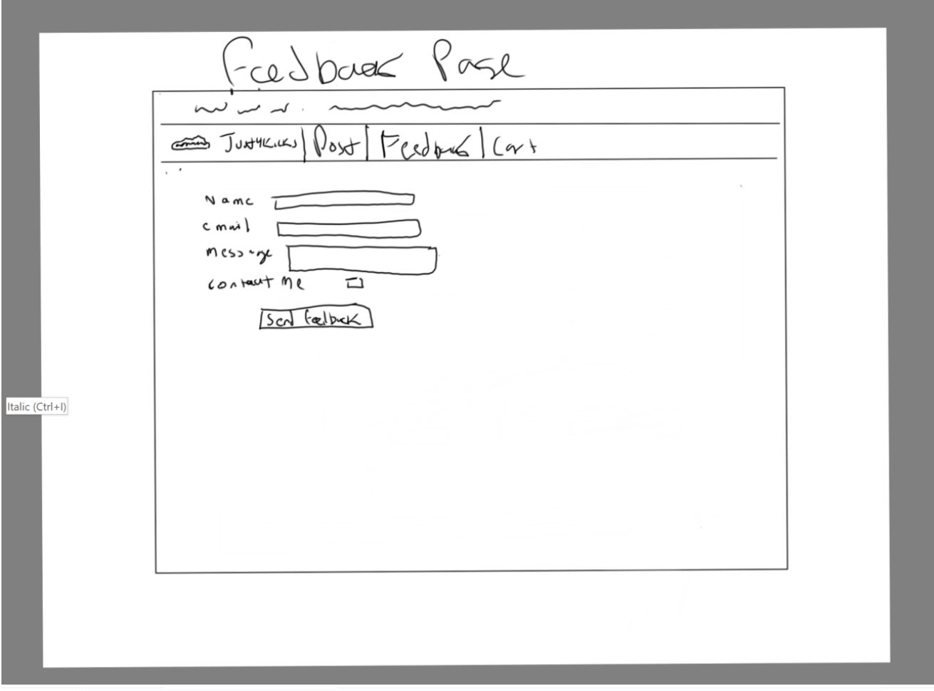

Slide 14
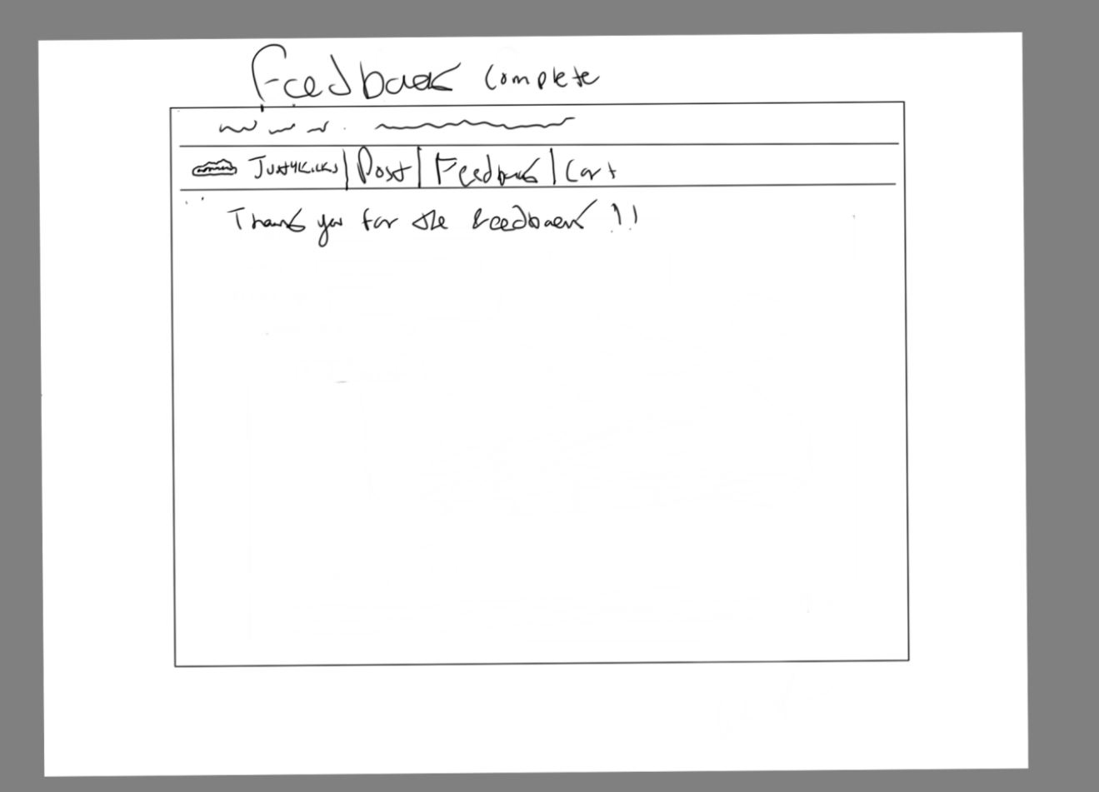

Slide 15
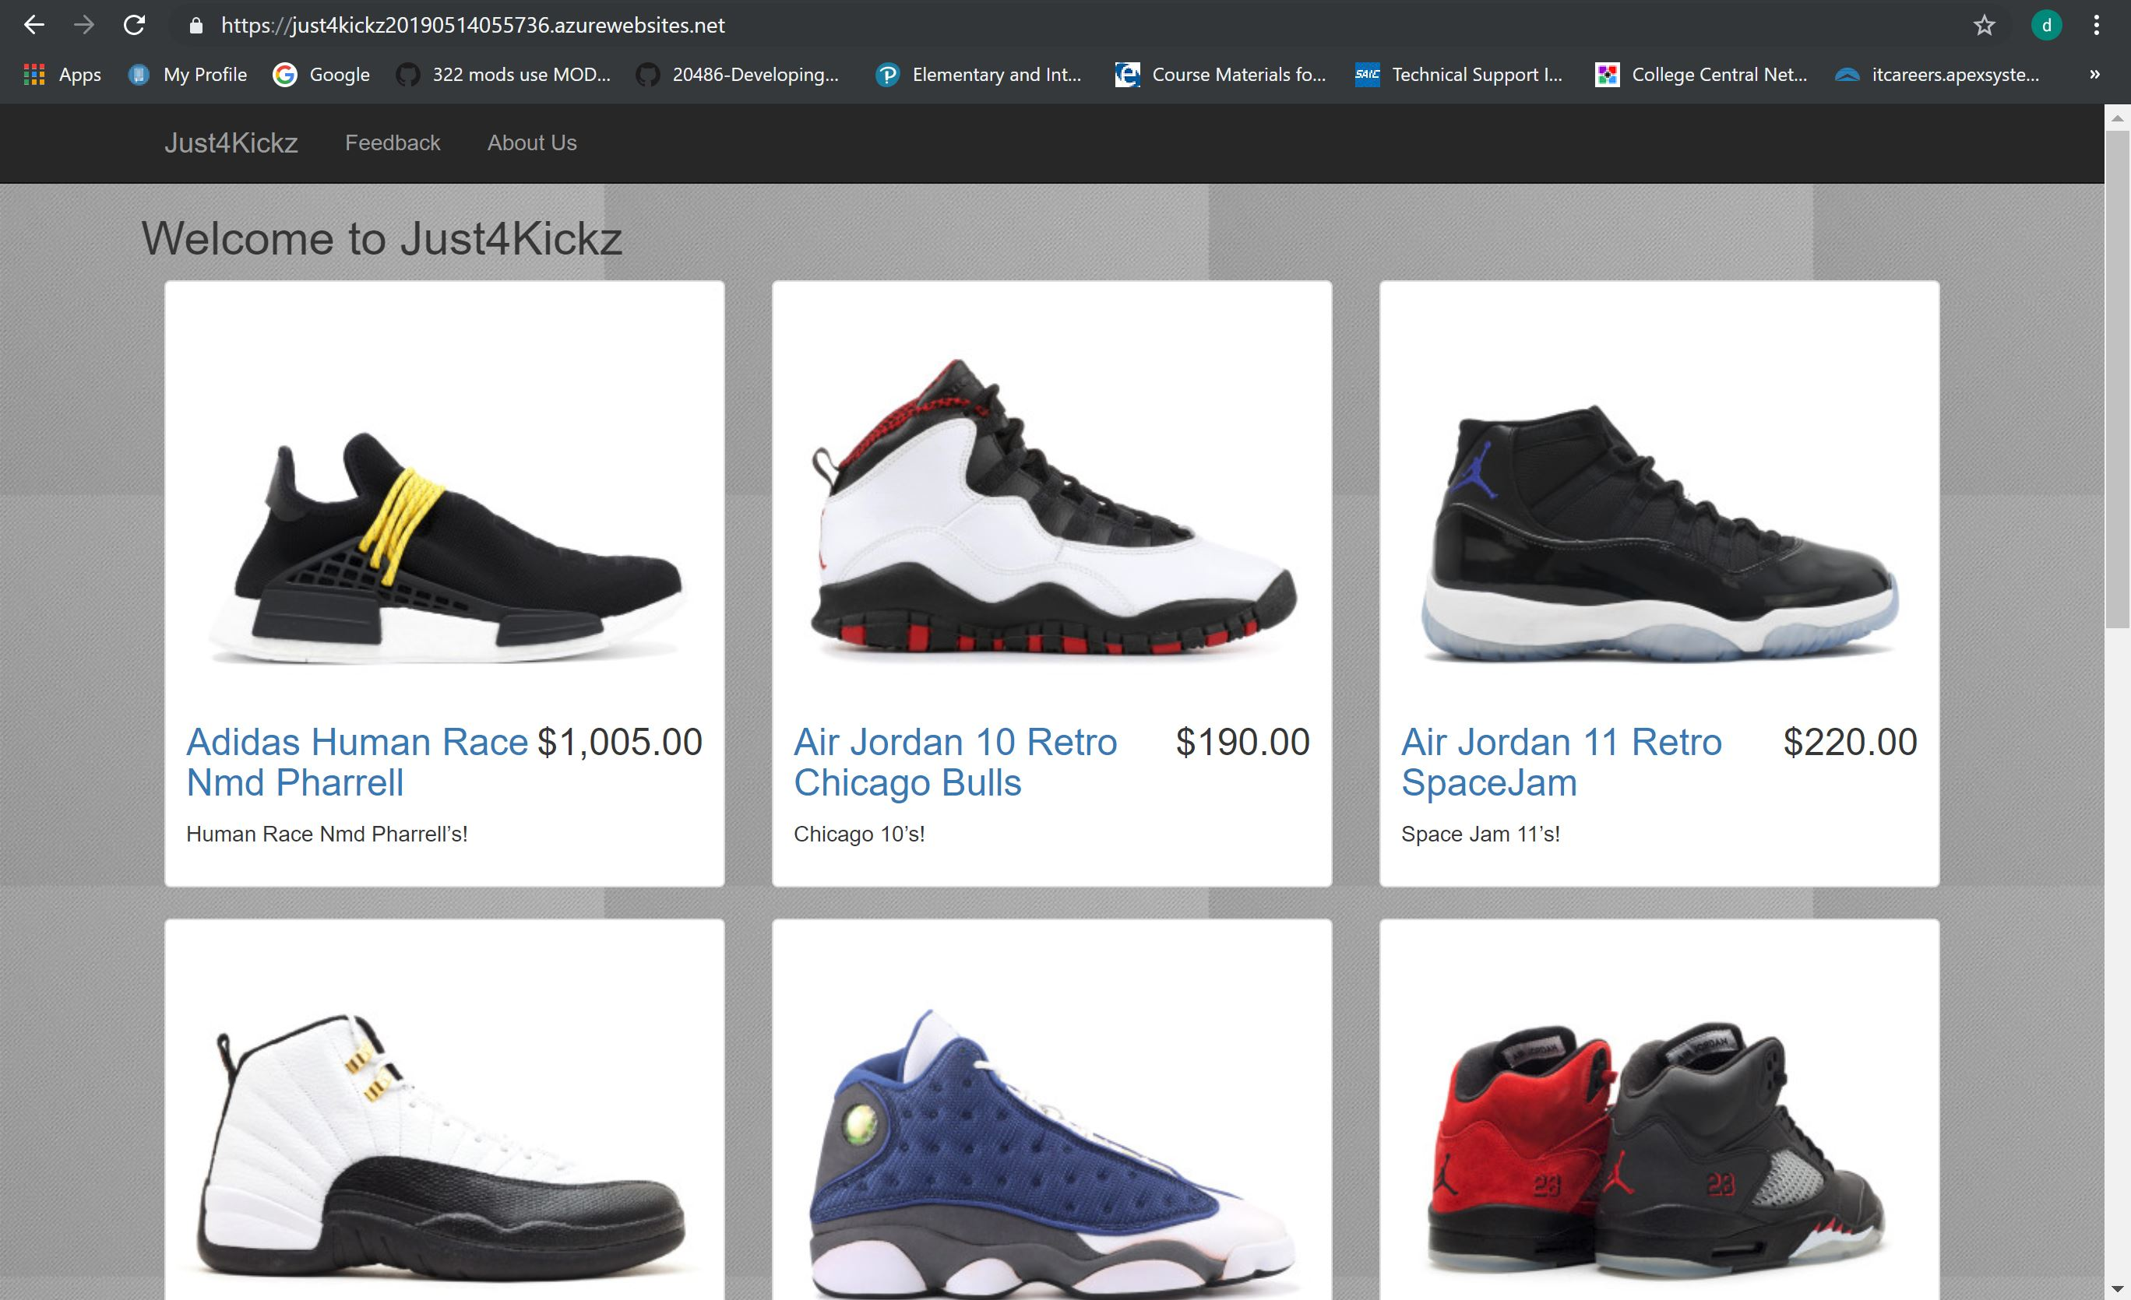

Slide 16
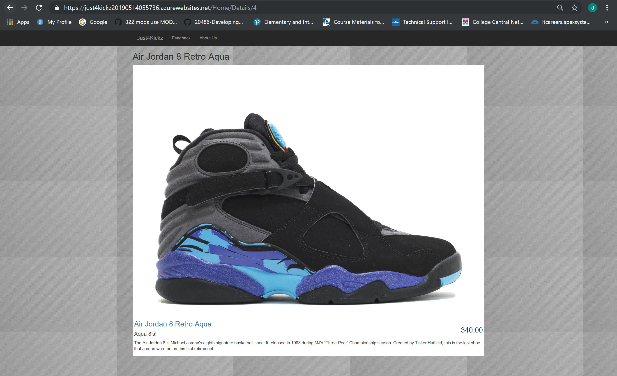

Slide 17
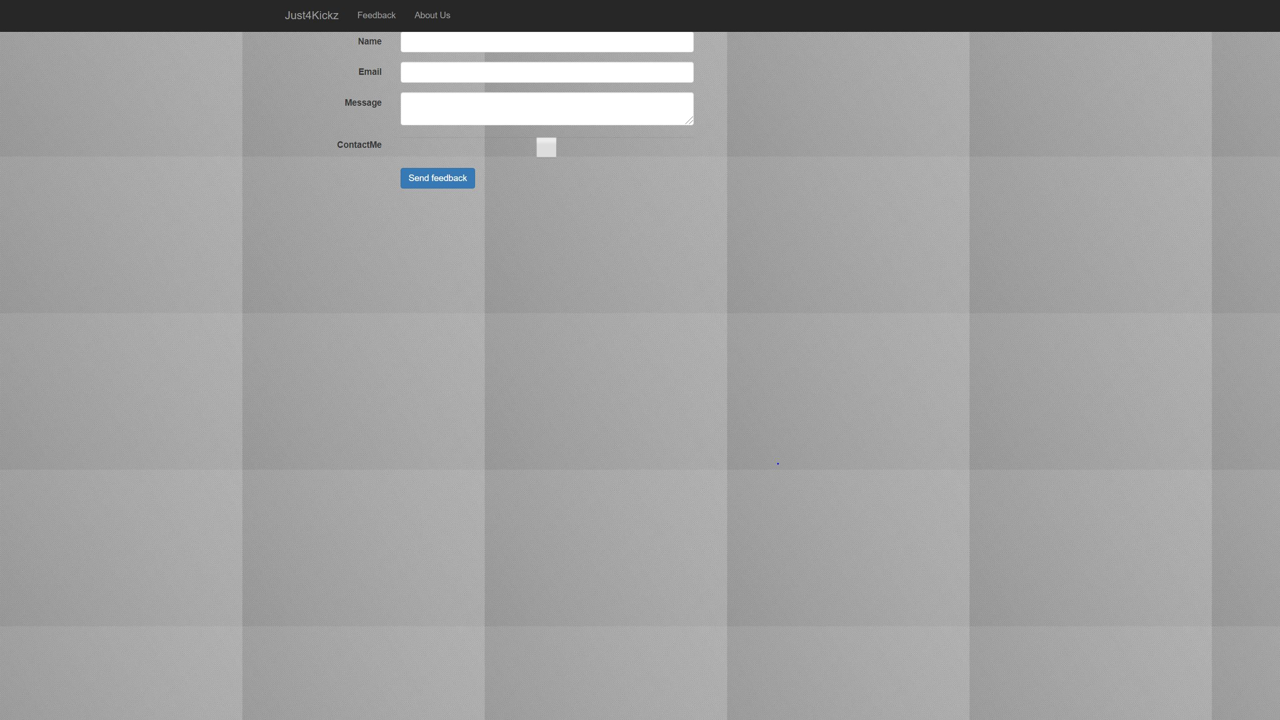

Slide 18
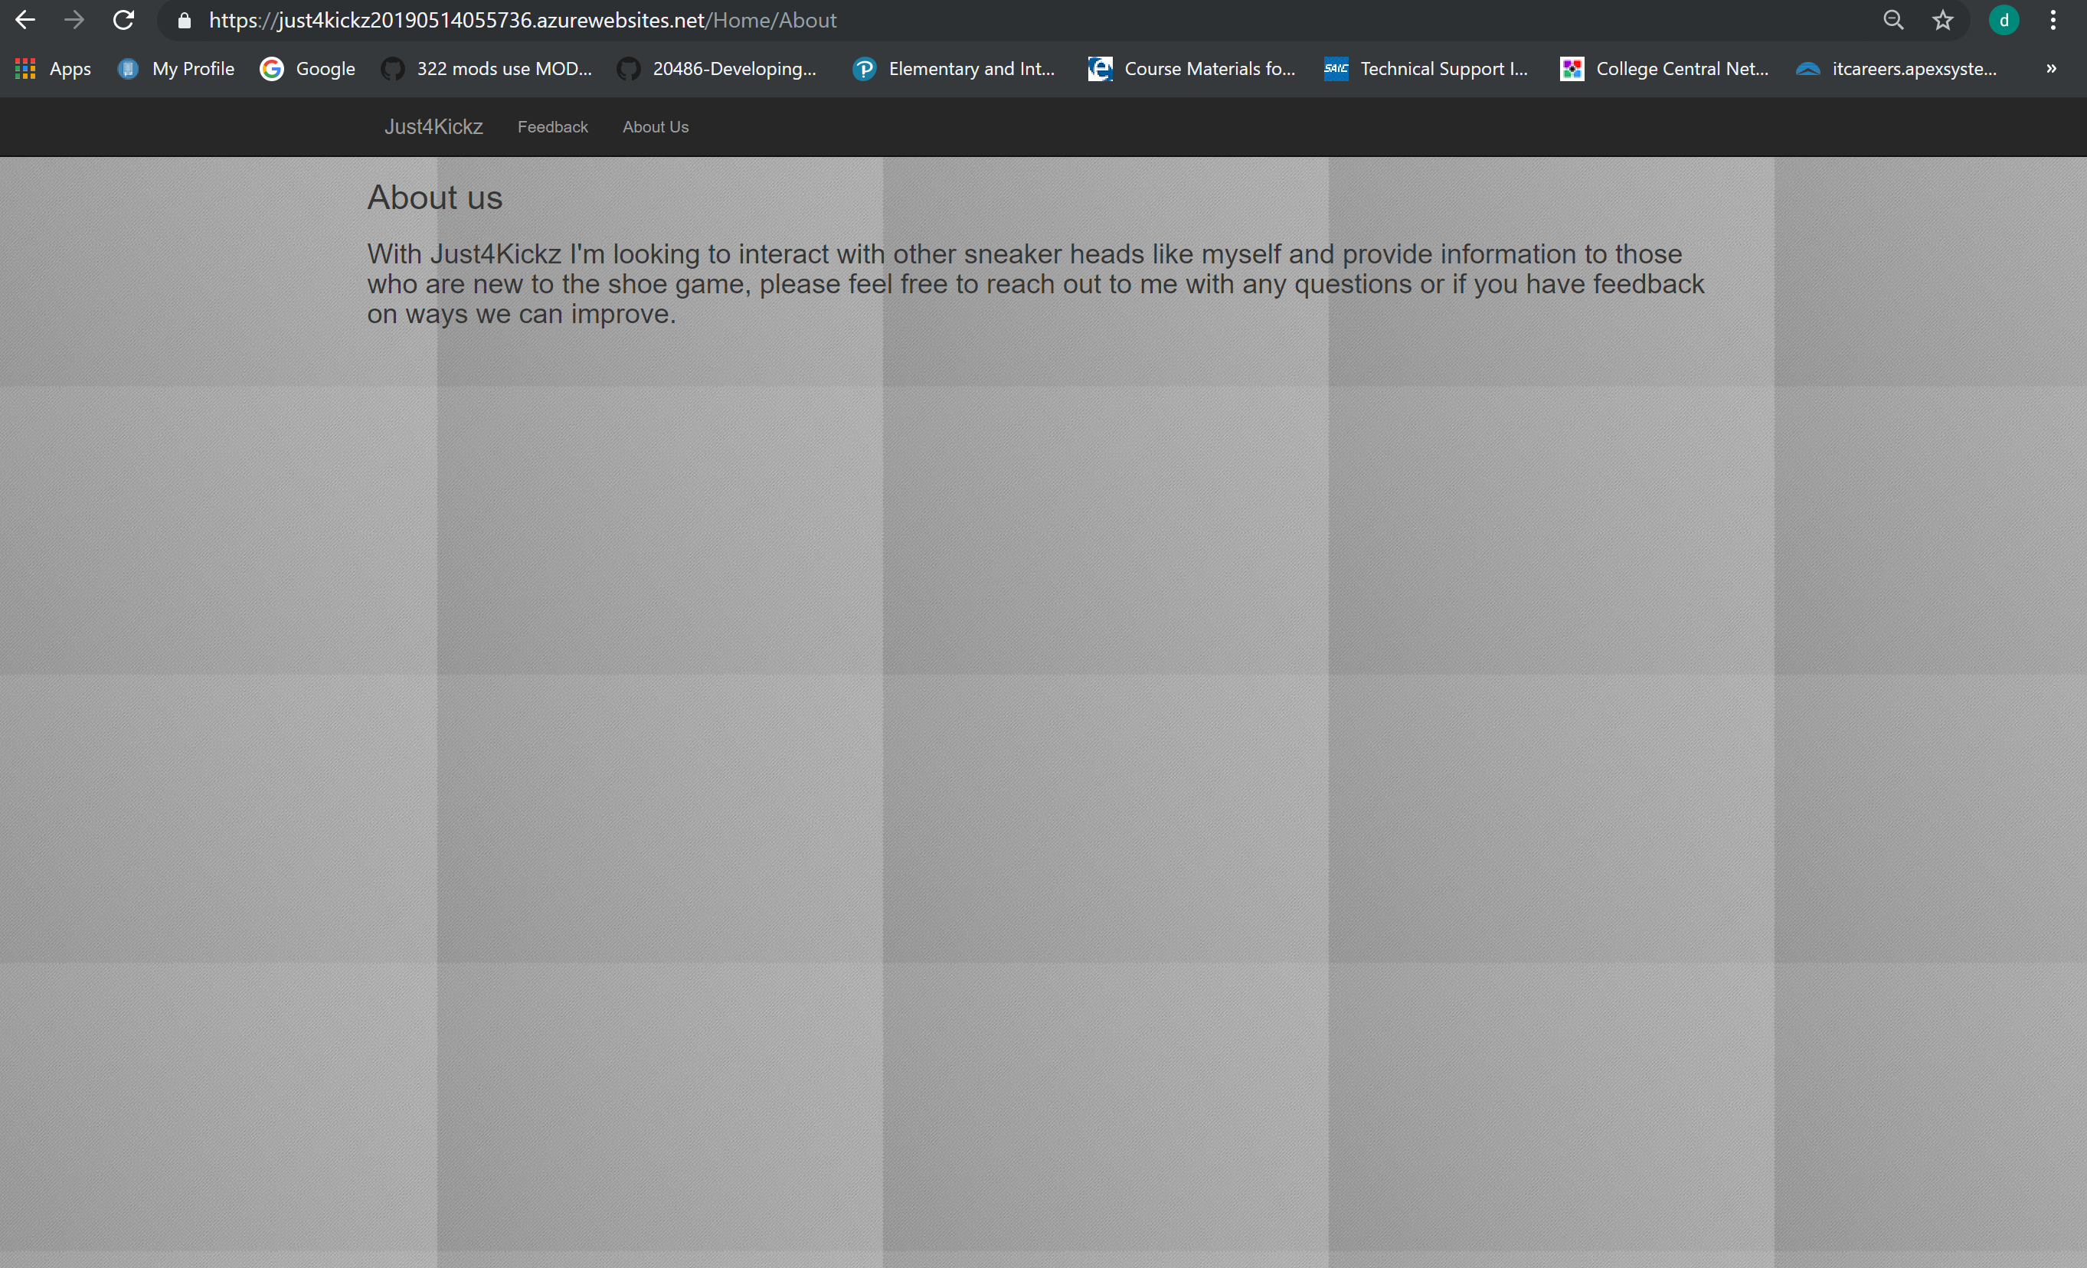

Slide 19
What makes us different
Open conversation where everyone with a love for the sneakers can get together and talk shoes.
Provide feedback that directly influence posts and ability to ask questions.

Slide 20
Github
https://github.com/DarwinRivera1

Slide 21
QUESTIONS ???

